Slide 1




ACCENTURE - SOCIAL BUZZ ANALYSIS

Slide 2
AGENDA
Project Recap
Problem
The Analytics Team
Process
Insights
RECOMMENDATIONS
Summary

Slide 3
PROJECT RECAP
Social Buzz is a fast-growing technology unicorn that needs to adapt quickly to its global scale. Accenture is currently focusing on:
An audit of Social Buzz’s big data practice.
Recommendation for a successful IPO.
Analysis to find Social Buzz’s top 5 most popular categories of content.

Slide 4
PROBLEM
Social Buzz, a company with a significant volume of data, seeks to adopt data best practices from leading corporations. Given their extensive data pool, Social Buzz is eager to grasp how top-tier enterprises navigate the complexities of big data management.

Slide 5

THE ANALYTICS TEAM
BELOWEI PETER DITORU-MUJE

Slide 6
THE PROCESS
Understanding the data given.
Data cleaning.
Data modelling.
Data analysis.
Uncover insights.

Slide 7
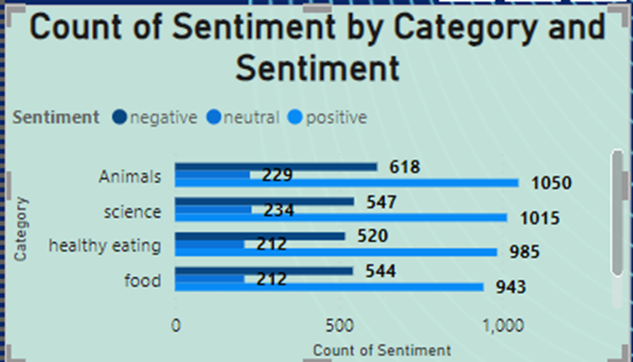
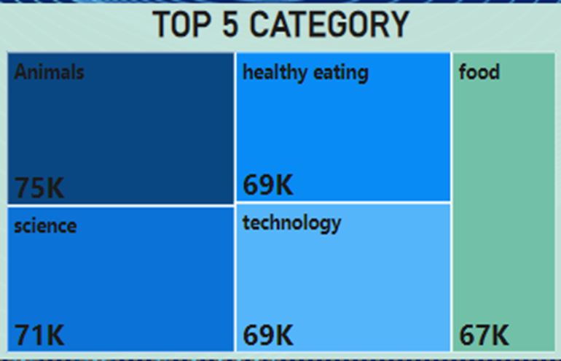
INSIGHTS
Top 5 category by sentiments
Top 5 Category

Slide 8
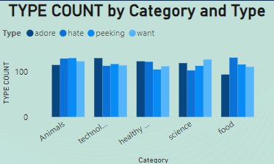
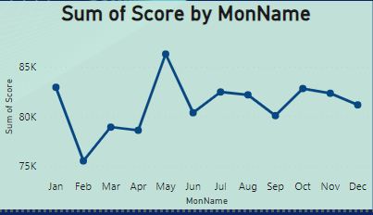
INSIGHTS
top 4 reaction types by top 5 category
Performance of each month

Slide 9
INSIGHTS
UNIQUE CATEGORIES
MOST POPULAR CATEGORY
BEST PERFORMING MONTH
MOST PROUCTIVE YEAR
16
ANIMAL
MAY
2020

Slide 10
INSIGHTS
UNIQUE REACTION TYPES
MOST POPULAR CONTENT
MOST POPULAR SENTIMENT
UNIQUE CONTENTS
16
PHOTO
POSITIVE
4

Slide 11
RECOMMENDATIONS
Considering that the Animal and Science segments garner the most attention, it's advisable to center efforts on generating additional content within these domains. This may encompass intriguing animal facts, breakthroughs in scientific research, or simplified explanations of intricate scientific principles presented in an engaging manner.
Highlighting the Technology category is pivotal due to its comparatively lower reaction count. Elucidating technological advancements or exploring the societal impact of technology can enhance interaction with tech-related content.
photos' popularity as the preferred content type across all top five categories.

Slide 12
RECOMMENDATIONS
Given that May boasts the highest overall posting frequency across the top five categories, maintaining a consistent posting schedule throughout the year, with particular emphasis during peak months, is crucial.
Employing visually captivating content, such as high-resolution images or infographics, is recommended to captivate audience interest and foster engagement.

Slide 13
SUMMARY
The data insights reveal a significant contrast between 2021 and 2020, with superior overall performance noted in 2020, particularly in response to photo content. The evident inclination toward photo content may stem from various factors such as its visual allure, capacity for memorability, ability to convey narratives, and sheer user preference.
Conducting additional analysis is advisable to uncover the precise drivers of this pronounced discrepancy between the two years and to provide insights for strategic decision-making concerning content creation, dissemination, and audience engagement initiatives.

Slide 14
THANK YOU!!!

